Slide 1
Web-based Layout Viewer
Mohamed Elatroush – 900152131
Omar Abugabal - 900162146
Hadeel Mabrouk - 900163213

Slide 2
Outline
GH repo URL
The used EDA formats
How to build and use the application
Dependencies
2 Test cases examples
Limitations
Algorithm(s) used
Validation/Verification
Future work

Slide 3
GH repo URL
https://github.com/MohamedElatroush/DEFTOSVG/

Slide 4
The Used EDA Formats
Library Exchange Format (LEF): to get information about the physical layout representation of the cells in the circuit
Design Exchange Format (DEF): to get the placement information of macros , standard cells, I/O pins and other physical entities.
Design Rule Checking (DRC) File: to display the present DRC violations.

Slide 5
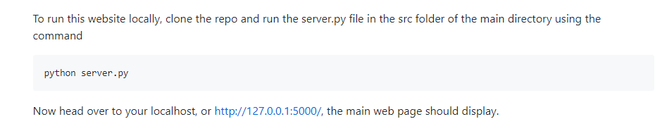
How to build and use the application

Slide 6
Dependencies
Flask
drawSvg
Regular Expression Operations (regex)
Lef_parser
Def_parser
Lef_util
Def_util

Slide 7
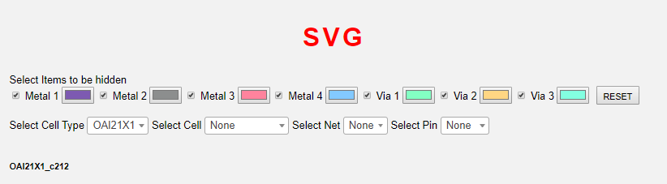
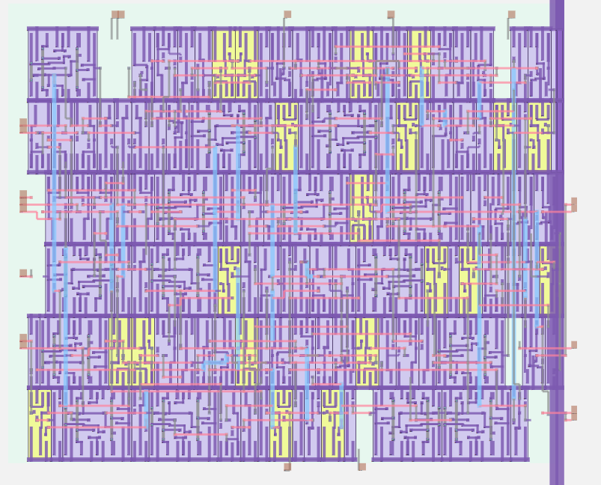
Test Case Example 1

Slide 8
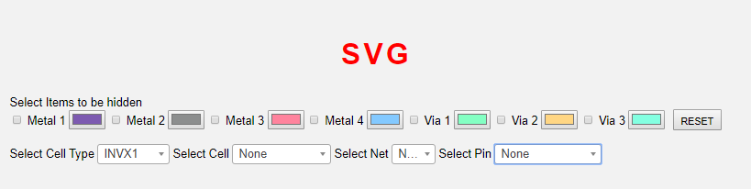
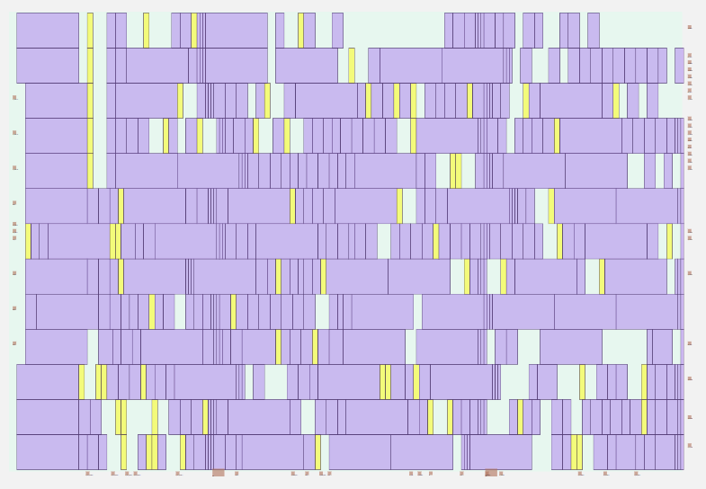
Test Case Example 2

Slide 9
Limitations
Slower response with enabling layers when circuit size gets higher

Slide 10
Algorithm
Parsing the LEF,DEF, and DRC files taken as inputs from the user
Generating SVG tag
Using Flask to add the generated SVG tag to the web page
Using jQuery to manipulate the SVG tag (e.g. enabling layers, highlighting,..etc)

Slide 11
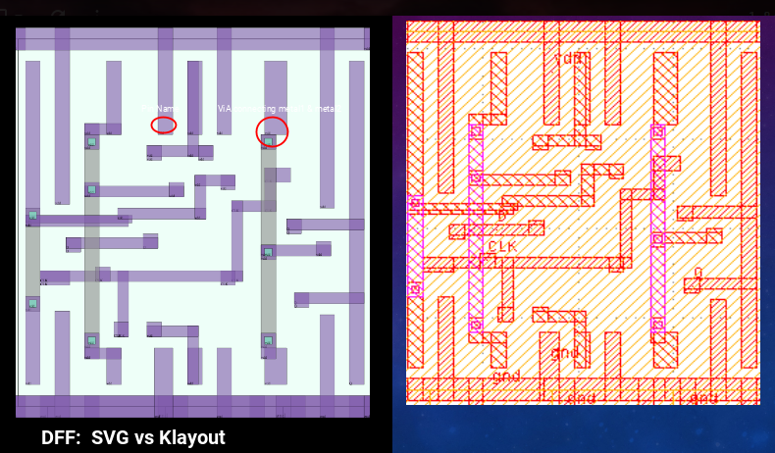
Validation/Verification (Klayout)

Slide 12
Future Work
Enhancing GUI and response time with large circuits
Developing a built-in DRC violations generator
Adding animations, styles, and stripples

